Slide 1
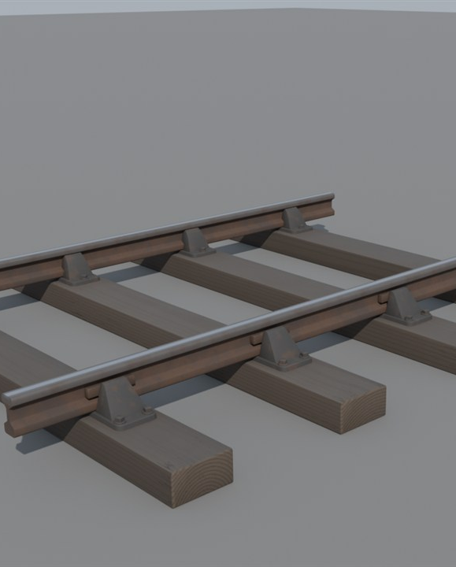
The Monorail Transition
What happens when the game's electric trains arrive, and how the mod plans to handle it.
Early Locomotion project (visual development, not final art).

Slide 2
How to read this guide
AGREED
Decided.
PROPOSED
Suggested, not confirmed.
PROVISIONAL
A test number that may change.
UNDECIDED
Still an open question.
BACKGROUND
A real-world fact.
Every idea carries a tag in the top-right corner.
2

Slide 3
Two kinds of railway
AGREED
Steam: two rails
Monorail: one beam
(the game's electric trains)
Steam runs on two rails. The game's later trains hug a single beam.
3

Slide 4
They cannot swap
AGREED
Cannot swap
Steam wheel
Clamp wheel
Steam wheels sit on rails. Monorail trains grip a beam. Neither can use the other's track.
4

Slide 5
Why electric wins in the end
AGREED
Cheap to start
Steam
Speed
Electric
Throughput
Shape only. Not measured.
Traffic density
Convenience
Electric rail wins on speed, throughput, traffic and convenience once a factory matures.
5

Slide 6
Upgrade in place
AGREED
1
2
3
Choose the electric track
Point at your steam track
It is replaced
Point the upgrade at your old track. It swaps in place, like upgrading a belt.
6

Slide 7
Your route stays
AGREED
Steam track
Same path
Monorail beam
PROPOSED
Supports and junction shapes kept where possible
The route you planned is kept. You do not start again.
7

Slide 8
A warning first
PROPOSED
Hologram preview
Steam trains cannot use this section.
!
Confirm
Cancel
Before you confirm, the game warns you. Steam trains cannot use the new track.
8

Slide 9
Will every shape fit?
UNDECIDED
Curves
Slopes
Clearances
Piece lengths
Connections
?
?
?
?
?
OQ12
Not every shape may convert. Exact copies are not promised yet.
9

Slide 10
Stations change too
PROPOSED
Steam station
Electric station
Water tower
Coal stage
Aligned replacement, not a morph
Platform
Signal box
A big steam station is replaced by a compact electric one on the same line.
10

Slide 11
Names and timetables
PROPOSED
Removed
Station name
Timetable
Coal stage
Water tower
Kept where possible
Your station name and timetable could carry over. Old coal and water gear is removed.
11

Slide 12
Signals change
PROPOSED
Not yet specified
Semaphore
Electronic signal
Mechanical signals may give way to electronic ones. The details are not set.
12

Slide 13
Mixed networks
PROPOSED
Steam branches
Electric main line
Interchange
Interchange
Interchange
Steam branches could live beside an electric main line.
13

Slide 14
Cargo crosses, trains do not
PROPOSED
Interchange
Steam network
Electric network
Steam trains cannot cross over
AGREED
Freight moves between the two networks at an interchange. Steam trains cannot cross over.
14

Slide 15
A Transfer Station?
UNDECIDED
?
Transfer Station
A special transfer building is only an idea. It is not promised.
15

Slide 16
What could go wrong?
UNDECIDED
?
?
?
?
Train on the track
Steam train stranded
Half-upgraded line
Junction boundary
OQ12
Some cases still need answers: busy track, stranded trains, half-converted lines.
16

Slide 17
Costs, refunds and undo
UNDECIDED
Cost and refund?
Undo or recovery?
Longest piece?
OQ12
Upgrade costs, refunds and an undo are not decided. Nor is the longest piece the game accepts.
17

Slide 18
The road to electric
PROVISIONAL
Tier 3:
Tier 3 to 4:
Tier 4 to 5:
Tier 6:
Early Steam Railways
Railway Expansion
Heavy Steam
Monorail
Tiers and prerequisites: provisional and undecided (OQ01)
UNDECIDED
Steam starts early. The monorail arrives in a later tier.
18

Slide 19
Every transport has a job
AGREED
Belts: permanent short and medium links
Tractors: flexible, little infrastructure
Steam: early long-distance bulk
Electric: mature speed and throughput
Belts, tractors, steam and electric rail each have a job. Electric leads when the factory matures.
19

Slide 20
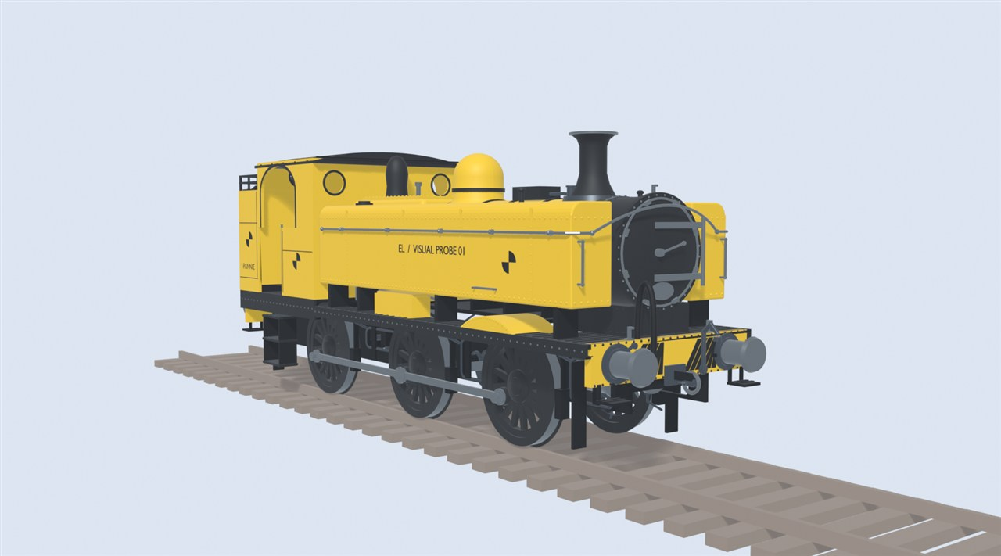
Where this stands
PROVISIONAL
Plans can change.
PROVISIONAL
Early test model, not final art.
1
2
3
4
5
Test engine on the game's rails
Upgrade in place
Station replacement
Mixed networks
Interchange
Under way
Planned
Planned
Planned
Planned
Conversion is planned. It is not built yet.
20

Slide 21
Still undecided
UNDECIDED
UNDECIDED · OQ12
UNDECIDED · OQ12
UNDECIDED · OQ12
UNDECIDED · OQ12
Exact copies of shapes
Costs and refunds
Undo and recovery
Occupied and stranded trains
UNDECIDED · OQ12
UNDECIDED · OQ03
UNDECIDED · OQ13
UNDECIDED · OQ01
Station and timetable carry-over
Signal upgrades
Transfer buildings in or out of Core?
Which tier unlocks the upgrade?
These questions are open. Nothing here has been chosen yet.
21

Slide 22
Image credits
Slot | Slide | Credit
R01 | 20 | Early Locomotion project (test model, not final art).
R02 | 1 | Early Locomotion project (visual development, not final art).
This deck uses no photographs.
22

